Slide 1
Lecture 1.2 - Introduction to Machine Learning

Slide 2

The GPU Teaching Kit is licensed by NVIDIA and New York University under the
Creative Commons Attribution-NonCommercial 4.0 International License.
Deck credit: J. Seng

Slide 3
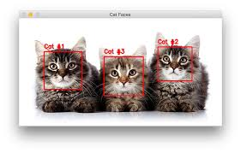
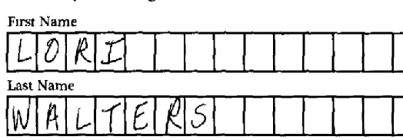
Machine Learning
Machine Learning is the ability to teach a computer without explicitly programming it
Examples are used to train computers to perform tasks that would be difficult to program
Notes:
Machine Learning relies on large quantities of data to train computers (OCR and detecting objects in images)
Computers can learn complex tasks that would require immense effort to program
Machine Learning is limited by the availability of examples and computational resources
With sufficient examples and computational power, computers can learn nearly any task
Models are the core component Machine Learning
A model is a method for using known examples to predict or produce inferences on new data.
Robots are exposed to noisy and dynamic environments, so programming a robot to handle all situations is infeasible
Therefore, engineers often use Machine Learning to teach robots to perform tasks, much like the way human children learn.

Slide 4
Types of Machine Learning
Supervised Learning
Training data is labeled
Goal is correctly label new data
Reinforcement Learning
Training data is unlabeled
System receives feedback for its actions
Goal is to perform better actions
Unsupervised Learning
Training data is unlabeled
Goal is to categorize the observations
Notes:
Supervised Learning is the most common type of machine learning.
An example of supervised learning is classifying emails as SPAM.
The training data is emails that are labeled as SPAM or HAM.
A model is then created that captures the relationship between email contents and the email label.
The model can then predict the category for new emails.
Reinforcement learning is commonly used in robotics because there is usually not labeled data
An example of reinforcement learning is teaching a robot to climb stairs.
The robot is “rewarded” for each step that it ascends, so it learns which actions are beneficial
Unsupervised learning is used in data mining to discover insights about unlabeled data
An example of unsupervised learning is grouping flowers based on their characteristics without knowing the flower species

Slide 5
Applications of Machine Learning
Handwriting Recognition
convert written letters into digital letters
Language Translation
translate spoken and or written languages (e.g. Google Translate)
Speech Recognition
convert voice snippets to text (e.g. Siri, Cortana, and Alexa)
Image Classification
label images with appropriate categories (e.g. Google Photos)
Autonomous Driving
enable cars to drive
Notes:
In recent years, Machine Learning has yielded impressive results in diverse disciplines.
There are many mobile apps available that let users take photos of handwritten characters and convert them to digital text.
Most translation software now uses machine learning to understand language translation since there is often not a one-to-one correspondence between words in different languages
Prior to machine learning speech recognition was frustrating and inaccurate, now machine learning enables robust speech recognition on a variety of devices
Consumers applications like Google Photos and Apple Photos automatically group photos by the people or places in them to make searching simple and intuitive
It would be impractical to program a car to handle every situation that could occur, but machine learning has enabled cars to self-driving cars to learn from their experiences

Slide 6
Features in Machine Learning
Features are the observations that are used to form predictions
For image classification, the pixels are the features
For voice recognition, the pitch and volume of the sound samples are the features
For autonomous cars, data from the cameras, range sensors, and GPS are features
Extracting relevant features is important for building a model
Time of day is an irrelevant feature when classifying images
Time of day is relevant when classifying emails because SPAM often occurs at night
Common Types of Features in Robotics
Pixels (RGB data)
Depth data (sonar, laser rangefinders)
Movement (encoder values)
Orientation or Acceleration (Gyroscope, Accelerometer, Compass)
Notes:
It is impossible to build a successful model if there are no useful features
Ideally features are easy to acquire and are robust to noise and environmental conditions
In many cases, the more features that are available the better; although it can require more time to learn models when there are many features
When designing a robot it is important to consider the benefits and costs associated with features
Laser range-finders are expensive, but the features that they produce (360 degree depth maps) are valuable for navigation
Cameras are less expensive, but it can be computationally expensive to produce depth data from cameras
Combining sensor data is often useful especially since some sensors work better in certain conditions

Slide 7
Measuring Success for Classification
True Positive: Correctly identified as relevant
True Negative: Correctly identified as not relevant
False Positive: Incorrectly labeled as relevant
False Negative: Incorrectly labeled as not relevant
Notes:
True positives and true negatives are considered “correct”
False positives and false negatives are “incorrect”.
In statistics, false positives are called type I errors and false negatives are type II errors
These terms are used when referring to single-class classification (e.g. an email is SPAM or not)
For multi-class classification, the number of true positives, true negatives, false positives, and false negatives can be assessed per class
In regression other measurements are used to determine how well the model performs

Slide 8

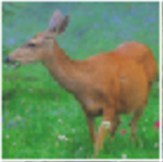
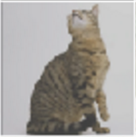
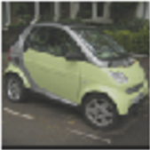

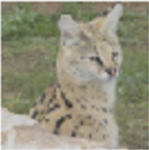
Example: Identify Cats
Prediction:
Image:
True
Positive
True
Negative
False
Negative
False
Positive
Images from the STL-10 dataset
Notes:
The final two images in the sequence are true negative and true positives, respectively
The plus sign is an image that is predicted to be a cat; the minus sign is an image that is predicted to be not a cat

Slide 9
Precision, Recall, and Accuracy
Precision
Percentage of positive labels that are correct
Precision = (# true positives) / (# true positives + # false positives)
Recall
Percentage of positive examples that are correctly labeled
Recall = (# true positives) / (# true positives + # false negatives)
Accuracy
Percentage of correct labels
Accuracy = (# true positives + # true negatives) / (# of samples)
Notes:
Oftentimes, accuracy is mistakenly used as the only metric for the quality of a model.
Unfortunately, using accuracy is misleading when there are very few true positives.
For example consider a dataset with 3 cats and 97 non-cats.
A model that predicts not-cat for each image would have an accuracy of 97% even though it is obviously not effective
In the cat example, precision is the number of correctly labeled cats divided by the number of times the model predicts cat
In the cat example, recall is the number of correctly labeled cats divided by the number of cat images

Slide 10
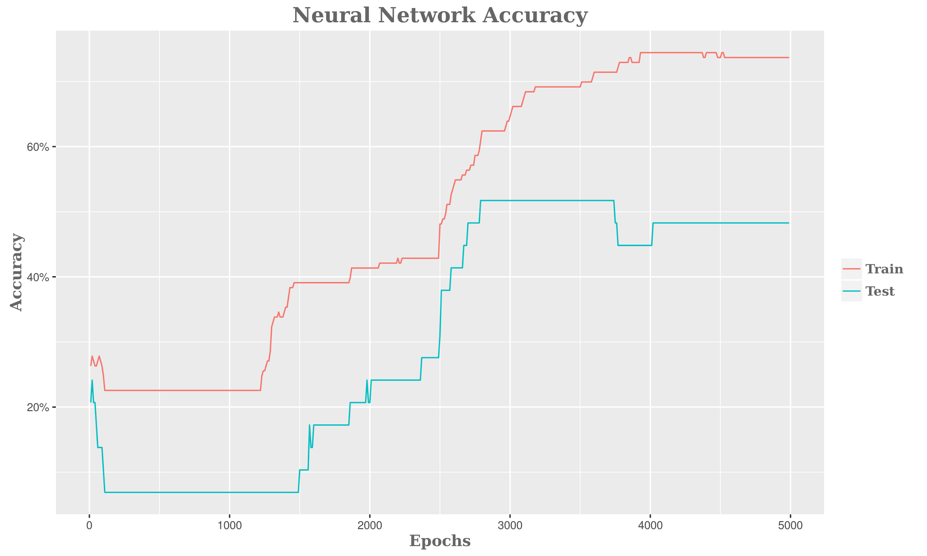
Training and Test Data
Training Data
data used to learn a model
Test Data
data used to assess the accuracy of model
Overfitting
Model performs well on training data but poorly on test data
Notes:
The quality of training data is important for creating a successful machine learning model
Ideally training data should be diverse and closely mimic the properties of the data that the model will be used on.
Test data must not be used to train the model because then it would be impossible to assess the effectiveness of the model
Overfitting is a common problem that happens when a model learns the training examples well, but is unable to generalize to new data
Overfitting can be avoided by using techniques like regularization and cross-validation

Slide 11
Bias and Variance
Bias: expected difference between model’s prediction and truth
Variance: how much the model differs among training sets
Model Scenarios
High Bias: Model makes inaccurate predictions on training data
High Variance: Model does not generalize to new datasets
Low Bias: Model makes accurate predictions on training data
Low Variance: Model generalizes to new datasets
Notes:
Bias is the average difference between the model’s predictions and the ground-truth (actual) values
Variance is the variability in the model’s predictions depending on its training data
Bias and Variance are typically inversely related.
An example of a high bias and low variance model is a model that always predicts cat
It’s bias is high because it frequently miss classifies the image, but its variance is low because its prediction results do not depend on the training data used
An example of a low bias and high variance model is a model that predicts cat if the image matches pixel-to-pixel with a cat in the training data
It’s bias is low in the training data because it has 100% correct labels, but its variance is high because it’s predictions will differ depending on what images are in the training data

Slide 12
Supervised Learning Algorithms
Linear Regression
Decision Trees
Support Vector Machines
K-Nearest Neighbor
Neural Networks
Notes:
Linear Regression is used to predict a continuous value (e.g. predict distance that a paper airplane will fly if given information about its weight, wings, etc)
Decision Trees are flowcharts where each node is an if-then statement. Often the decision trees are binary where each node has two child nodes
Support Vector Machines are used for classification; they work by finding a hyperplane that separates the data by features into classes
K-Nearest Neighbor is a simple algorithm that predicts the value of an input based on the value of the k-closest training examples
Neural Networks are models that mimic the brain to learn complex non-linear relationships.

Slide 13
Supervised Learning Frameworks
Tool | Uses | Language
Scikit-Learn | Classification, Regression, Clustering | Python
Spark MLlib | Classification, Regression, Clustering | Scala, R, Java
Weka | Classification, Regression, Clustering | Java
Caffe | Neural Networks | C++, Python
TensorFlow | Neural Networks | Python

Slide 14
Thank you

